Slide 1
Matthews Southwest plans to construct the apartment tower at 2400 Bryan Street next door to the historic Dallas High School building.
The 15-story building will have about 230 apartments, with more than 100 of the units reserved for below-market rents. Residents in the planned project would have to earn between 30 percent and 60 percent of the area's median household income to qualify for the affordable rental units.
The project is expected to break ground early next year and be completed by Aug. 31, 2021.

Slide 2
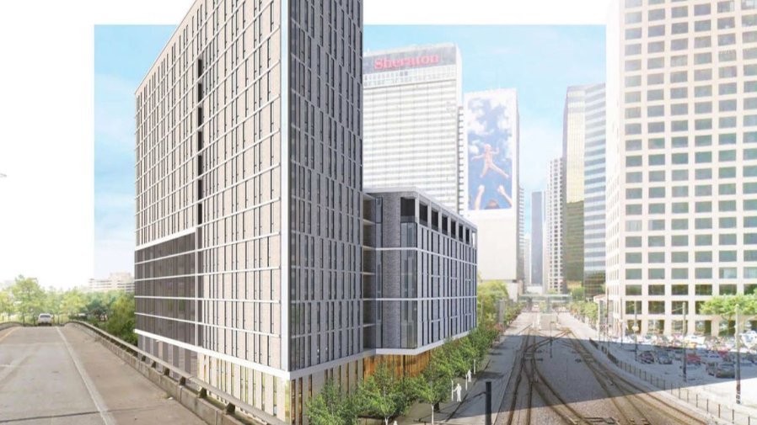

Slide 3
http://www.matthewssouthwest.com/projects/

Slide 4
Habitat for Humanities' Cotton Groves project in McKinney will create affordable housing out of steel shipping containers.
http://www.cottongroves.com/

Slide 5
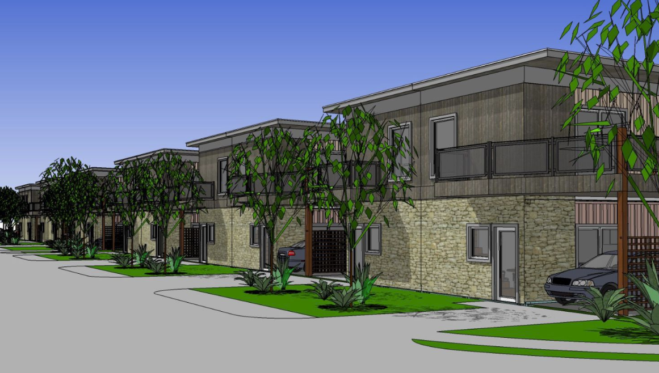

Slide 6
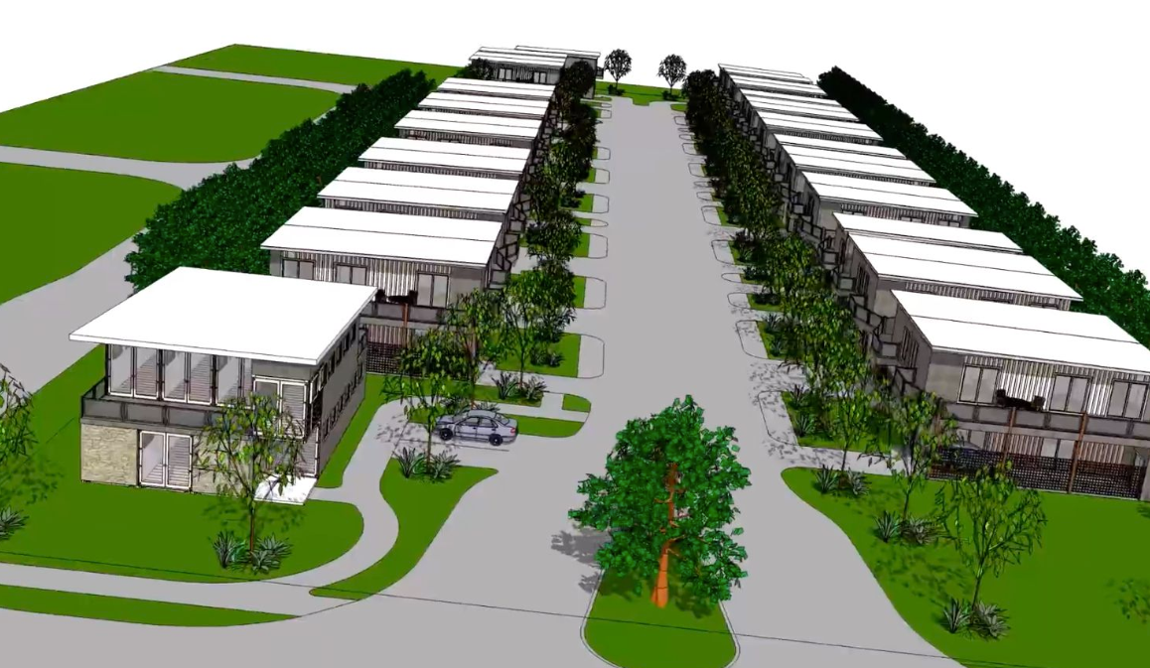

Slide 7
The median home price in McKinney is $338,000, according to the most recent data.
Habitat will bolt the metal boxes together and stack them to build each of its new homes on McKinney's east side.
Four containers will be bolted together to erect the 1,280-square-foot, three-bedroom plan.
The 8- by 40-foot metal boxes will get doors and windows and will be finished out inside like standard homes.
Concrete piers for the foundations.

Slide 8
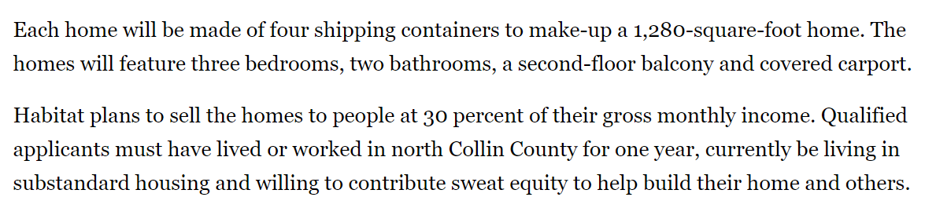
A new neighborhood on the way in Collin County won't be a standard suburban tract home community.
The McKinney development will have almost three dozen houses built out of shipping containers. North Collin County Habitat for Humanity plans to build the neighborhood, called Cotton Groves, to provide affordable housing in Dallas' pricey northern suburbs.
"We could have sold all of them already on the open market," said Celeste H. Cox, CEO of the North Collin County Habitat for Humanity. "We have a waiting list of 70 families."

Slide 9
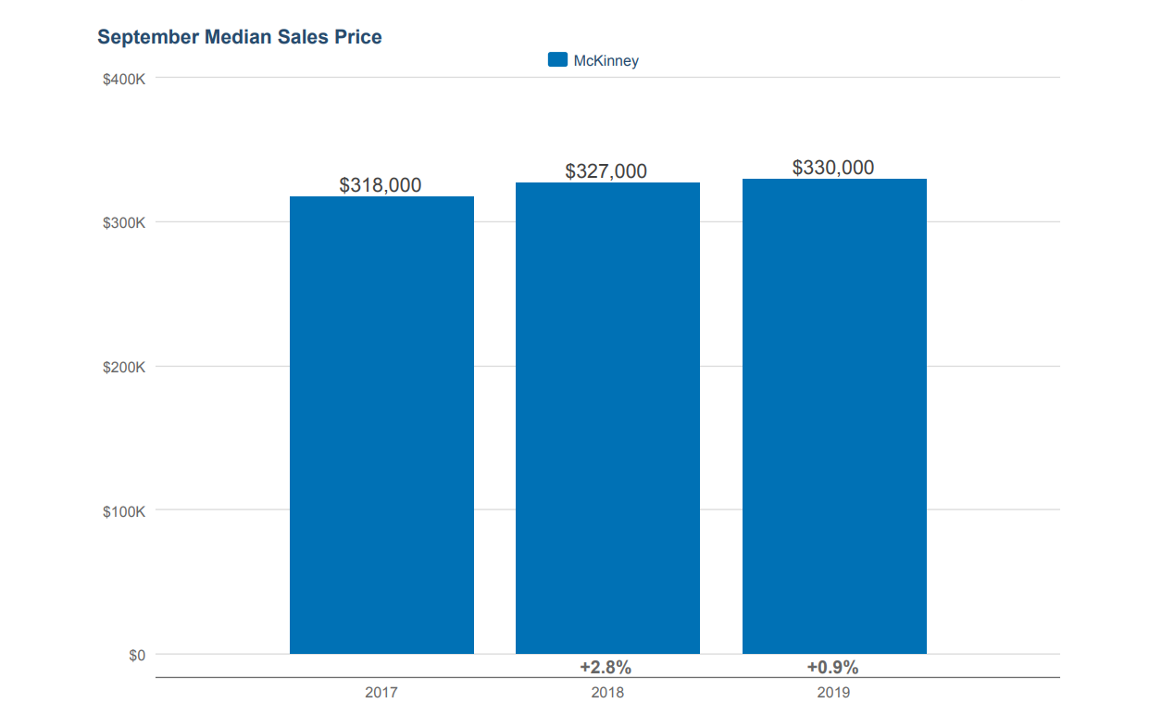

Slide 10
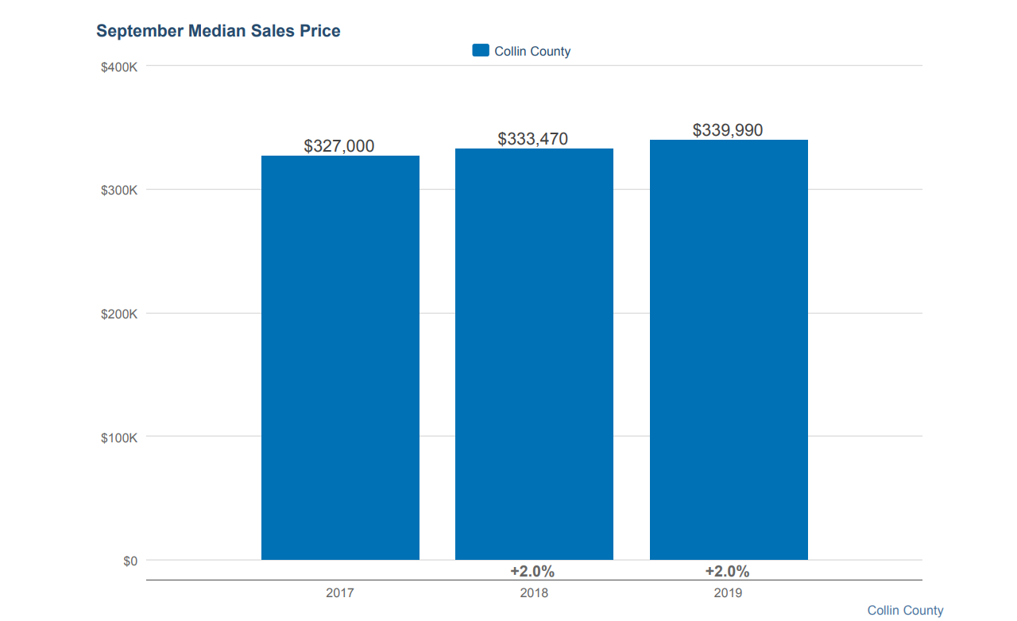

Slide 11
Dingman's plans for the neighborhood show modern-style houses with stone on the first-floor exteriors and carports with wood screens.
"We anticipate doing at least three phases," he said. "So far, there's been quite a bit of interest."
Dingman said he reviewed other projects that used shipping containers for a variety of commercial and residential uses.
"For the past 12 years, I've been the in-house architect for Adriatica Village," a mixed-use McKinney development designed to look like an Eastern European village, he said. "I do custom homes and small commercial buildings."
Dingman said his only previous work with shipping containers was when he used two of them as part of the construction of a Dallas bar.
Habitat plans to sell each of the McKinney container homes for 30 percent of the buying family's gross income.
"They will cost about the same" as Habitat's regular houses, Cox said. "A lot of people are watching this project to see how it turns out."

Slide 12
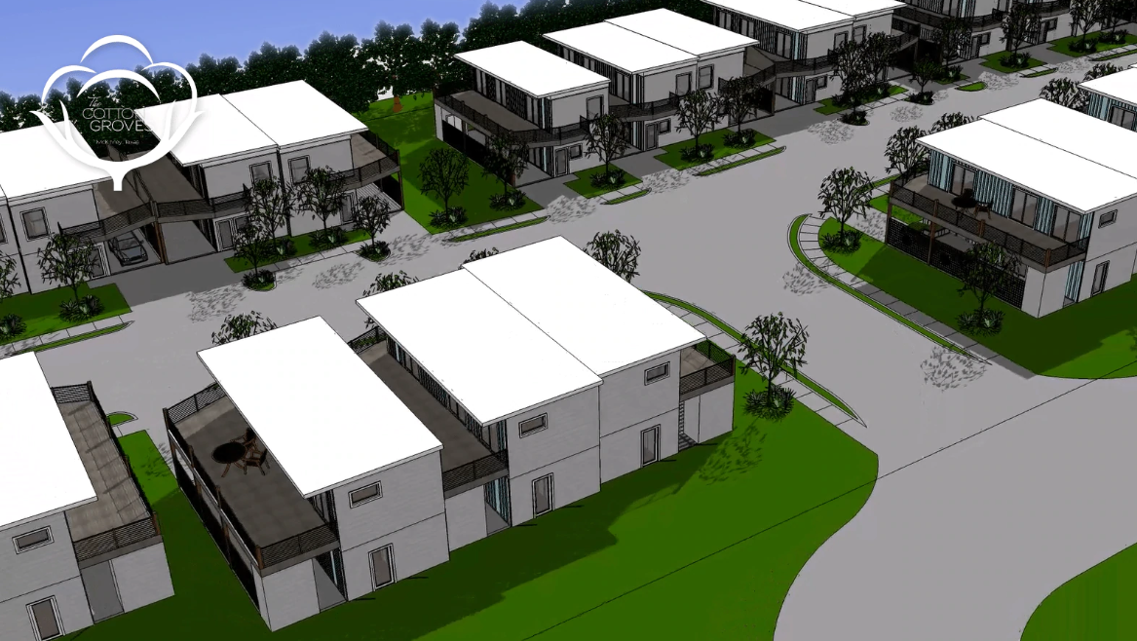

Slide 13
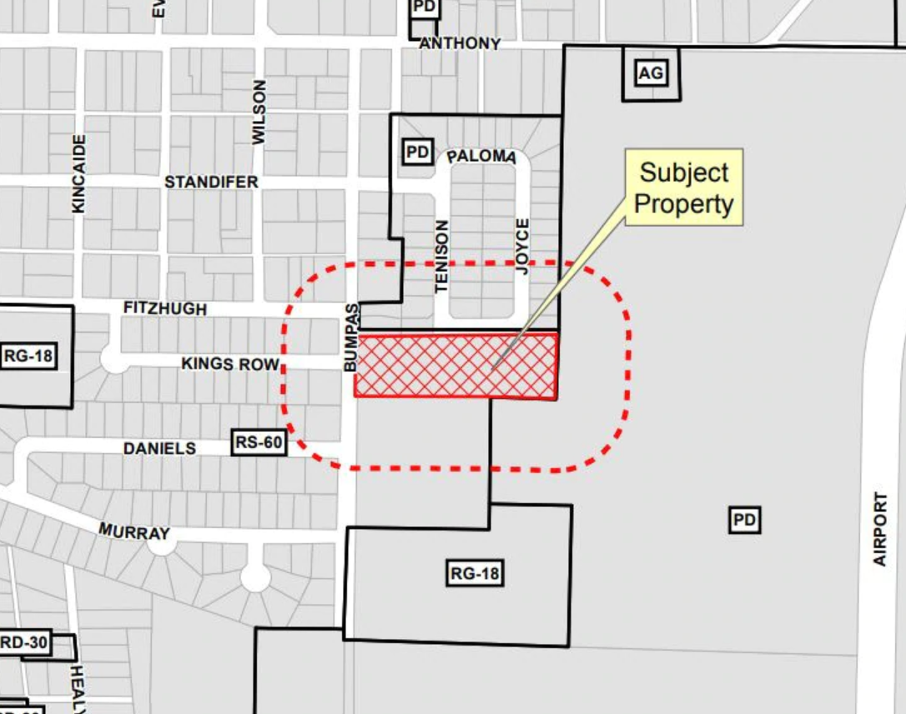

Slide 14
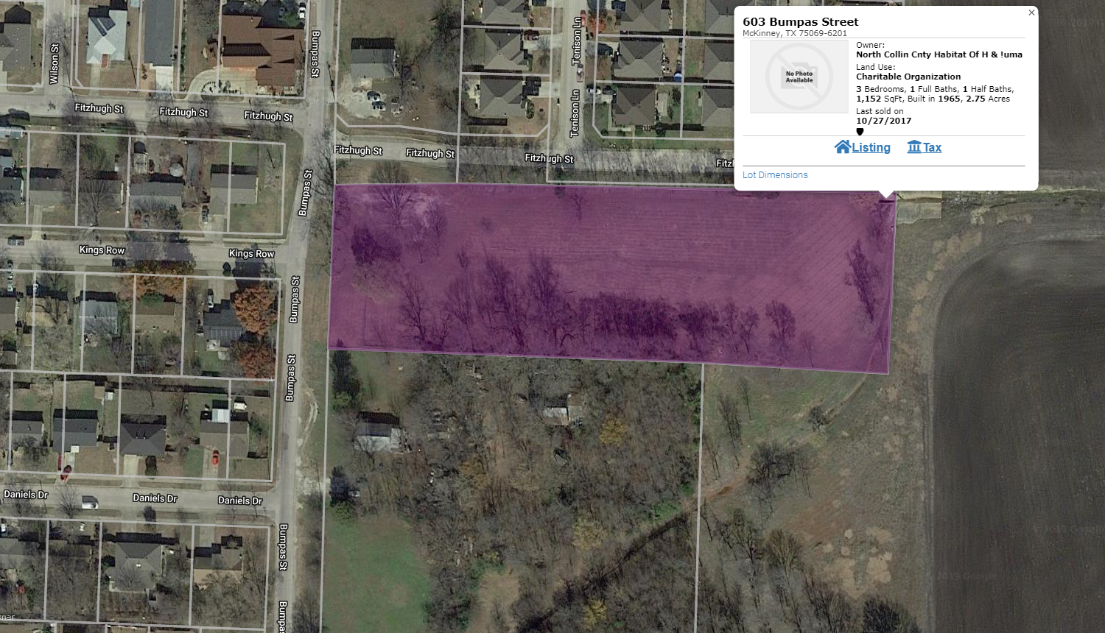

Slide 15
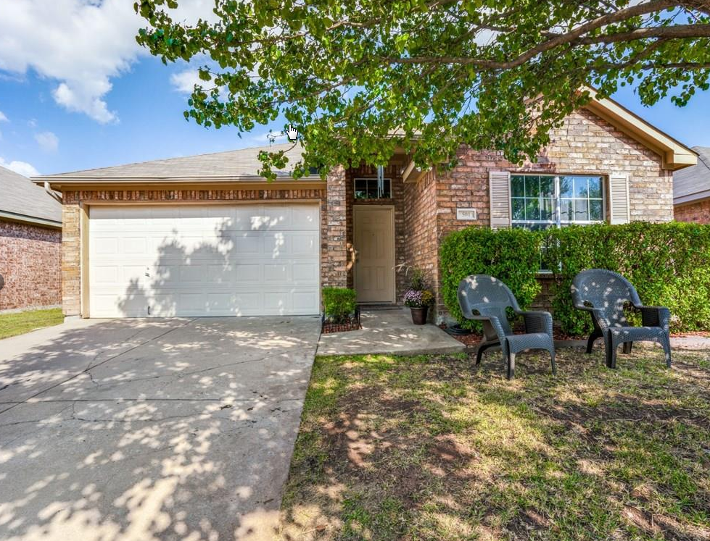
Neighborhood just north of site –
On the market for $220,000.

Slide 16
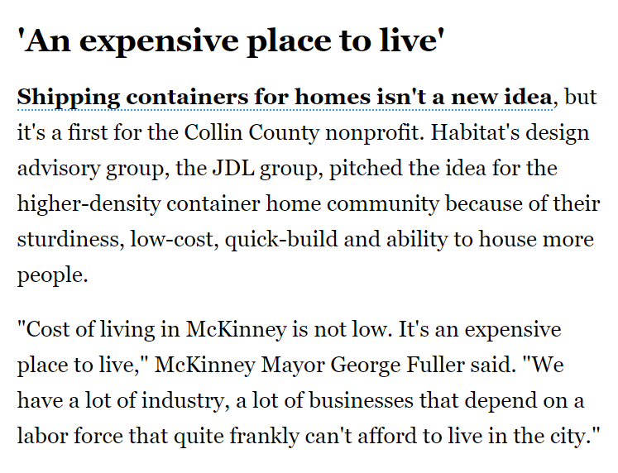

Slide 18
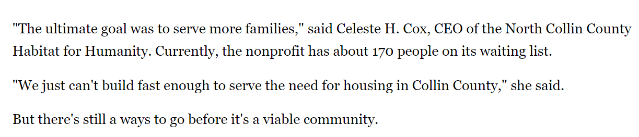

Slide 19
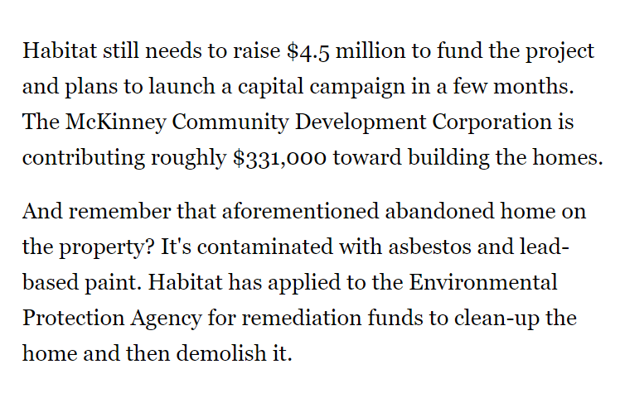

Slide 20
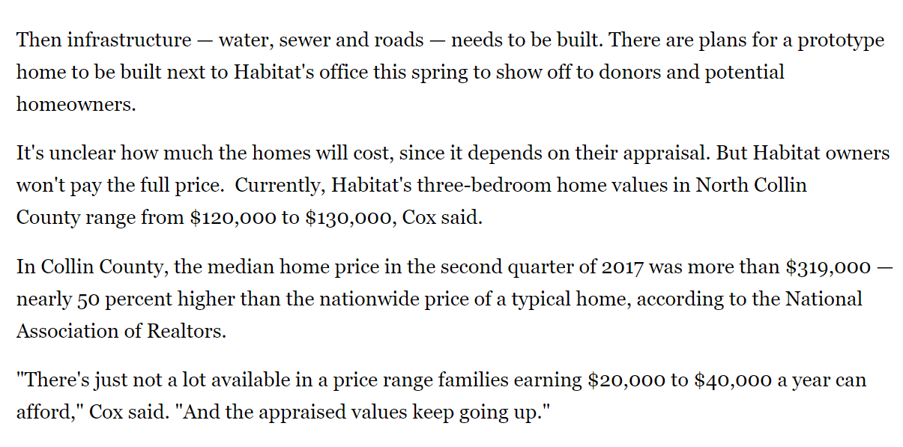

Slide 21
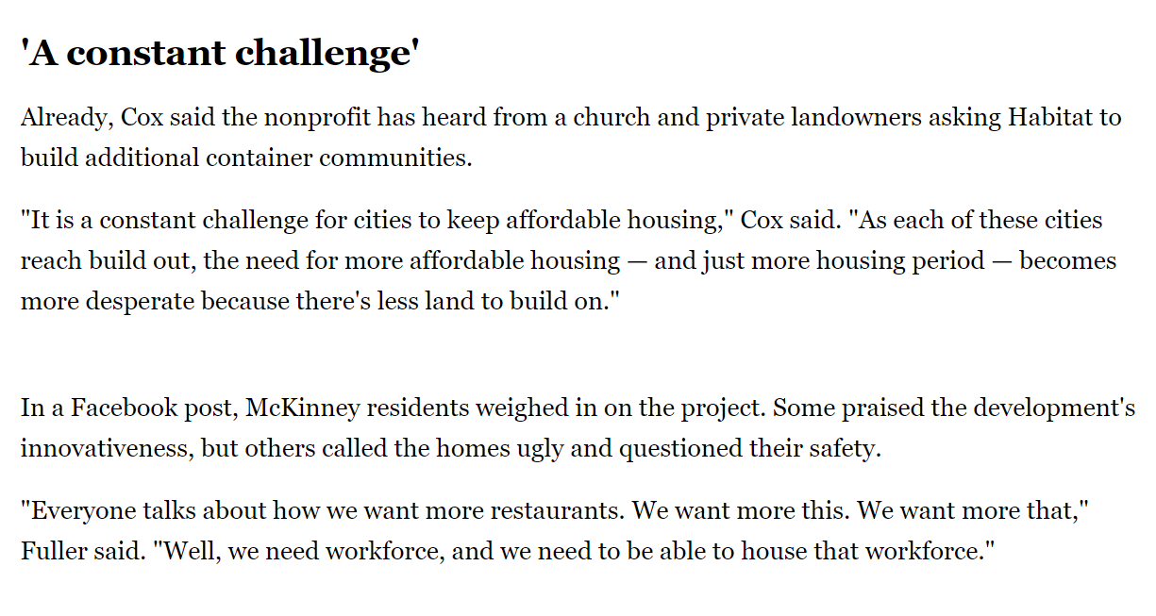

Slide 22
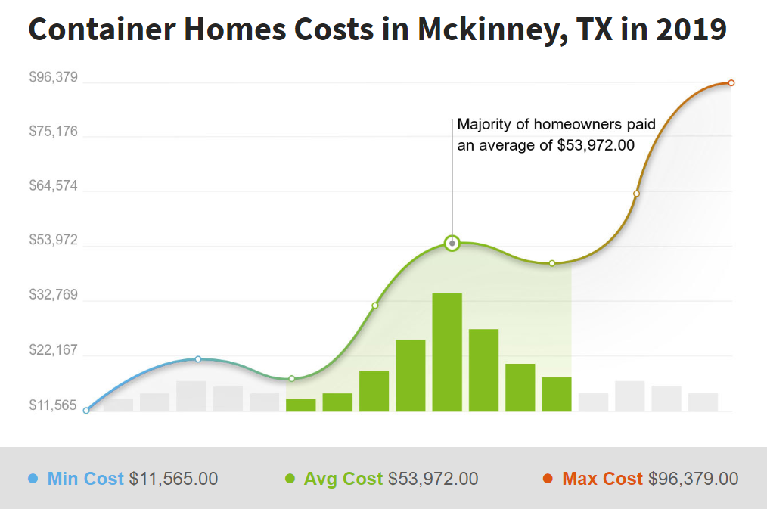

Slide 23
Homes you can purchase for under $130,000 in Collin County on the following slides. As you can see from the following slides this new development of mobile homes offer tremendous value for families with low income.

Slide 24
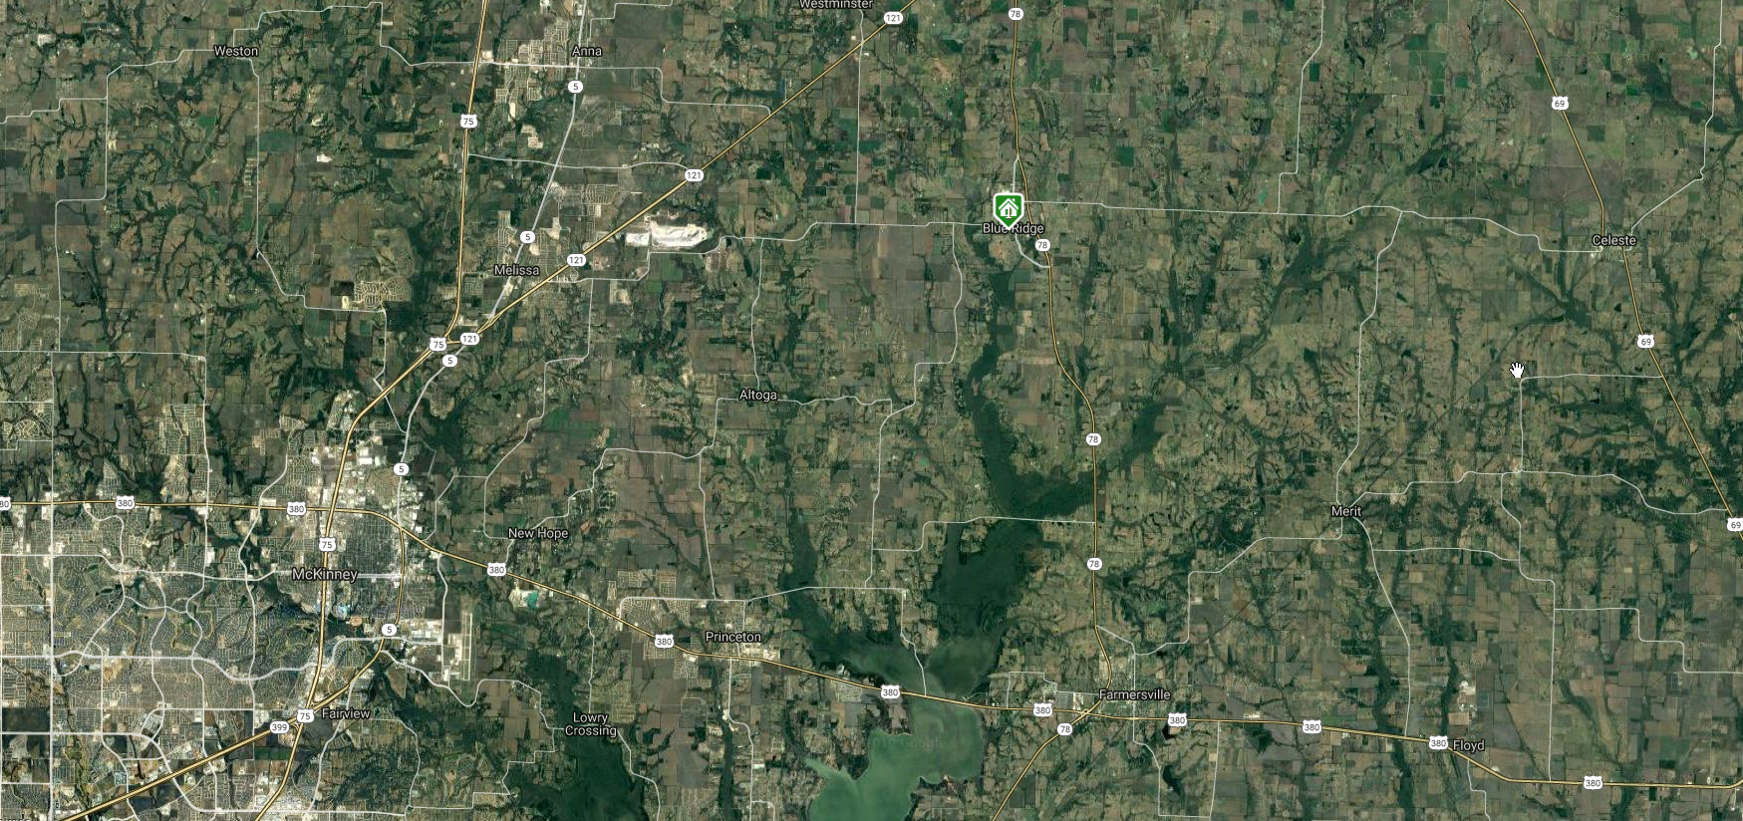
100 Beryl Lane, Blue Ridge Texas, 75242. $125,000. ~ 20 miles NE of McKinney. House on following slide.

Slide 25
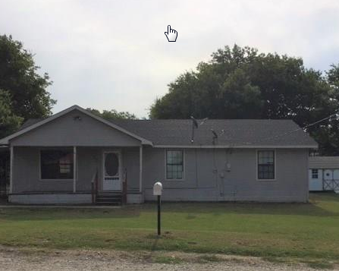

Slide 26
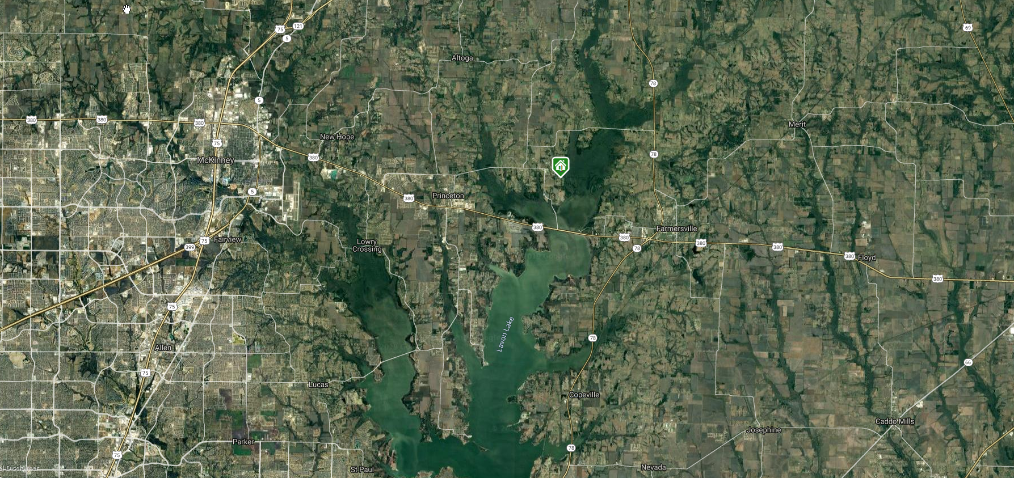
Manufactured Home - 12120 CR 563, Princeton TX, 75407
On the market for $135,000. Located ~ 15 miles east of McKinney

Slide 27
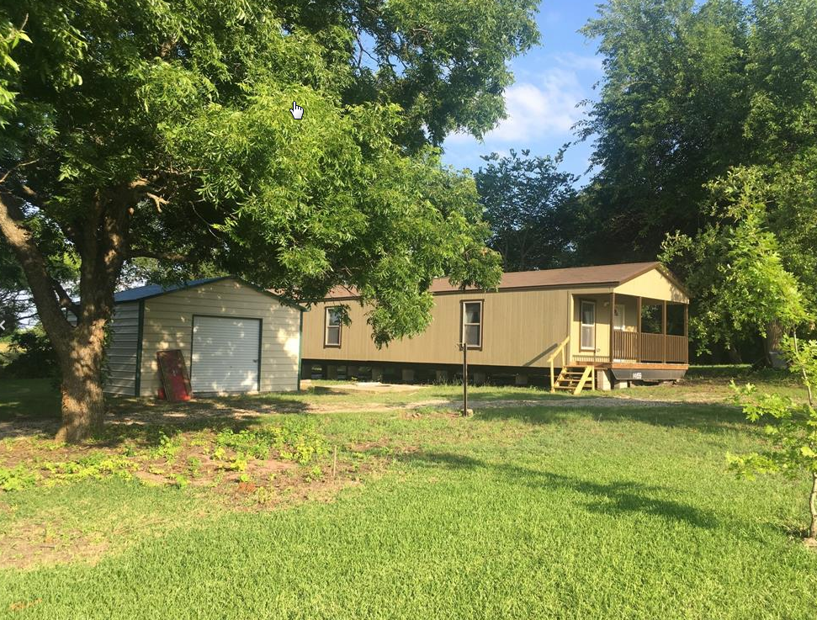

Slide 28
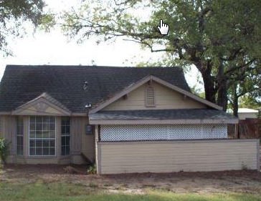
111 McKinney Avenue, Princeton, TX 75407
On the market for $77,000. Located ~ 11 miles east of McKinney.

Slide 29
